Slide 1
STAT 504 – Network and Text Analytics Lecture 8: Review
By Dr. Ellie Small

Slide 2
Overview
Topics:
Review
Lecture 1
Lecture 2
Lecture 3
Lecture 4
Lecture 5
Lecture 6
Lecture 7

Slide 3

Review
Highlights of Lecture 7
Degree centrality considers a vertex to be central if it has a high degree compared to the other vertices in the network. For a digraph, it also considers vertices with high in-degree, and to a lesser degree high out-degree, to be central. Use degree.
Closeness centrality considers a vertex to be central if it is close to many other vertices, i.e. if its distance to all other vertices is small. Use closeness. This measure is calculated by component and should only be used to compare vertices in the same component.
Betweenness centrality summarizes the extend to which a vertex is located on shortest paths between other pairs of vertices. Use betweenness. Betweenness centrality is rarely used for digraphs.
Eigenvector centrality measures status, prestige, or rank, and assigns a high centrality to vertices depending on how central its neighbors are. Use eigen_centrality.
Google’s PageRank is an eigenvector-based centrality measure for digraphs, assigning a high centrality to vertices when they have neighbors with a high PageRank and low out-degree. Use page_rank.
Vertices with low degree and high betweenness are sometimes referred to as brokers.
For a digraph: A high hub score is assigned to vertices that have many edges going out to vertices with high authority scores (use hub_score), and a high authority score is assigned to vertices that have many edges coming in from vertices with high hub scores (use authority_score).
Edge betweenness centrality for a specific edge calculates the proportion of shortest paths between two vertices in a network that include that edge.
A line graph of a graph G is a graph such that its vertices equal the edges of $G$, with an edge if there is a vertex between the original 2 edges in $G$. Use make_line_graph.
Network Cohesion is the extend to which subsets of vertices are cohesive with respect to the relationship that defines the edges of the network.
Dyads are pairs of vertices, which in a digraph can take on three states: null (no directed edges), asymmetric (one directed edge) or mutual (two directed edges). Use dyad.census.
Triads are triples of vertices that can take on 16 states, from having no directed edges to having three mutual directed edges. Use triad_census.
Transitivity of a graph, also called clustering coefficient, indicates the probability that a connected triple in a graph is closed. Use transitivity.
Local transitivity gives the proportion of pairs of neighbors of a vertex that are closed, i.e. for which there is also an edge between those two neighbors.
Reciprocity for a digraph is the proportion of edges that are reciprocated, i.e. for which there is also an edge in the opposite direction. Ratio reciprocity for a digraph is the number of mutual dyads divided by the number of asymmetric and mutual dyads.
The small world property is the fact that in many networks, perhaps most, the typical (mean) distance between pairs of vertices is surprisingly short (mean_distance).
Assortative mixing refers to linking among vertices according to a certain characteristic, and an assortativity coefficient determines the extend to which this linking occurs according to this characteristic. Use assortativity_nominal for categorical characteristics, assortativity for continuous characteristics. When the continuous characteristic is the degree, we may use assortativity_degree. The assortativity coefficient lies between -1 and 1, where zero indicates no relationship, i.e. no assortativity, and 1 indicates a perfect relationship, or perfect assortativity. Negative values indicate disassortativity.
Homework 7 Review

Slide 4
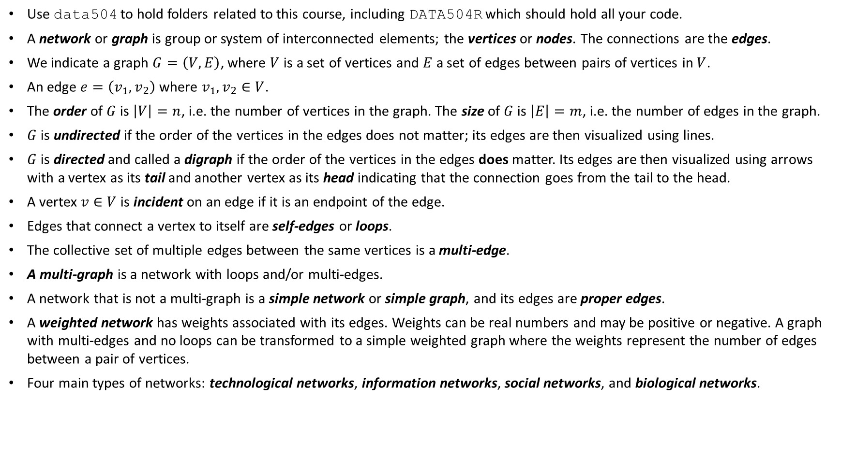
Lecture 1
Use data504 to hold folders related to this course, including DATA504R which should hold all your code.
A network or graph is group or system of interconnected elements; the vertices or nodes. The connections are the edges.
We indicate a graph $G=\left(V,E\right)$, where $V$ is a set of vertices and $E$ a set of edges between pairs of vertices in $V$.
An edge $e=\left(v_{1},v_{2}\right)$ where $v_{1},v_{2}∈V$.
The order of $G$ is $\left|V\right|=n$, i.e. the number of vertices in the graph. The size of $G$ is $\left|E\right|=m$, i.e. the number of edges in the graph.
$G$ is undirected if the order of the vertices in the edges does not matter; its edges are then visualized using lines.
$G$ is directed and called a digraph if the order of the vertices in the edges does matter. Its edges are then visualized using arrows with a vertex as its tail and another vertex as its head indicating that the connection goes from the tail to the head.
A vertex $v∈V$ is incident on an edge if it is an endpoint of the edge.
Edges that connect a vertex to itself are self-edges or loops.
The collective set of multiple edges between the same vertices is a multi-edge.
A multi-graph is a network with loops and/or multi-edges.
A network that is not a multi-graph is a simple network or simple graph, and its edges are proper edges.
A weighted network has weights associated with its edges. Weights can be real numbers and may be positive or negative. A graph with multi-edges and no loops can be transformed to a simple weighted graph where the weights represent the number of edges between a pair of vertices.
Four main types of networks: technological networks, information networks, social networks, and biological networks.

Slide 5
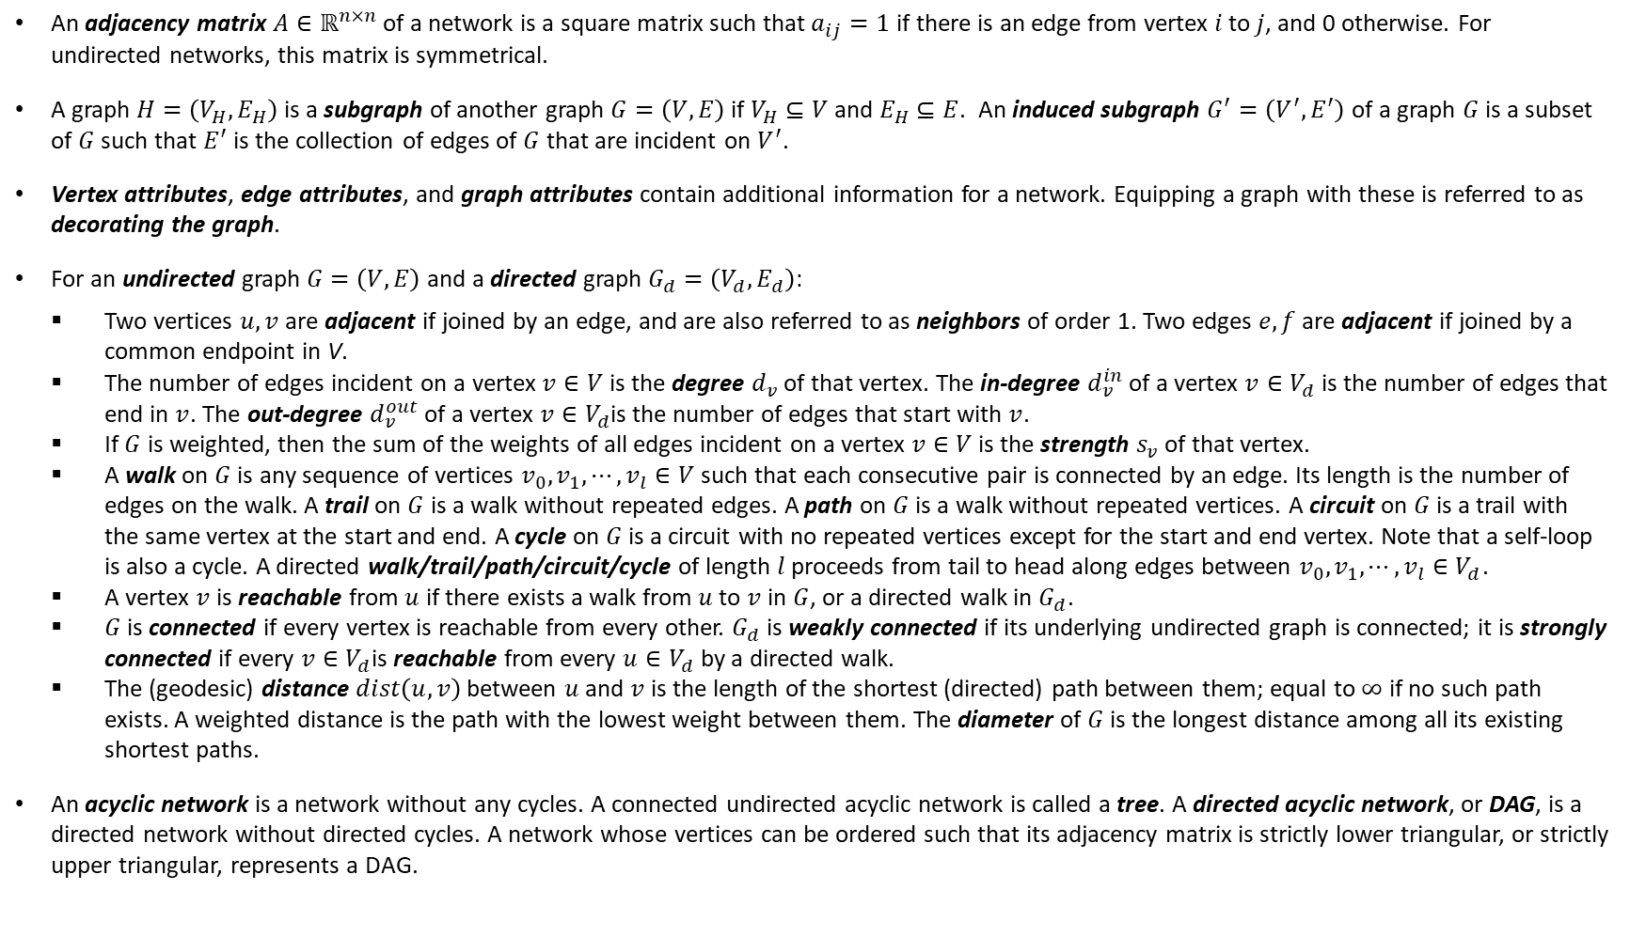
Lecture 2
An adjacency matrix $A∈ℝ^{n×n}$ of a network is a square matrix such that $a_{ij}=1$ if there is an edge from vertex $i$ to $j$, and 0 otherwise. For undirected networks, this matrix is symmetrical.
A graph $H=\left(V_{H},E_{H}\right)$ is a subgraph of another graph $G=\left(V,E\right)$if $V_{H}⊆V$ and $E_{H}⊆E$. An induced subgraph $G^{′}=\left(V^{′},E^{′}\right)$ of a graph $G$ is a subset of $G$ such that $E^{′}$ is the collection of edges of $G$ that are incident on $V^{′}$.
Vertex attributes, edge attributes, and graph attributes contain additional information for a network. Equipping a graph with these is referred to as decorating the graph.
For an undirected graph $G=\left(V,E\right)$ and a directed graph $G_{d}=\left(V_{d},E_{d}\right)$:
Two vertices $u,v$ are adjacent if joined by an edge, and are also referred to as neighbors of order 1. Two edges $e,f$ are adjacent if joined by a common endpoint in V.
The number of edges incident on a vertex $v∈V$ is the degree $d_{v}$ of that vertex. The in-degree $d_{v}^{in}$ of a vertex $v∈V_{d}$ is the number of edges that end in $v$. The out-degree $d_{v}^{out}$ of a vertex $v∈V_{d}$is the number of edges that start with $v$.
If $G$ is weighted, then the sum of the weights of all edges incident on a vertex $v∈V$ is the strength $s_{v}$ of that vertex.
A walk on $G$ is any sequence of vertices $v_{0}, v_{1},⋯,v_{l}∈V$ such that each consecutive pair is connected by an edge. Its length is the number of edges on the walk. A trail on $G$ is a walk without repeated edges. A path on $G$ is a walk without repeated vertices. A circuit on $G$ is a trail with the same vertex at the start and end. A cycle on $G$ is a circuit with no repeated vertices except for the start and end vertex. Note that a self-loop is also a cycle. A directed walk/trail/path/circuit/cycle of length $l$ proceeds from tail to head along edges between $v_{0}, v_{1},⋯,v_{l}∈V_{d}$.
A vertex $v$ is reachable from $u$ if there exists a walk from $u$ to $v$ in $G$, or a directed walk in $G_{d}$.
$G$ is connected if every vertex is reachable from every other. $G_{d}$ is weakly connected if its underlying undirected graph is connected; it is strongly connected if every $v∈V_{d}$is reachable from every $u∈V_{d}$ by a directed walk.
The (geodesic) distance $dist\left(u,v\right)$ between $u$ and $v$ is the length of the shortest (directed) path between them; equal to $∞$ if no such path exists. A weighted distance is the path with the lowest weight between them. The diameter of $G$ is the longest distance among all its existing shortest paths.
An acyclic network is a network without any cycles. A connected undirected acyclic network is called a tree. A directed acyclic network, or DAG, is a directed network without directed cycles. A network whose vertices can be ordered such that its adjacency matrix is strictly lower triangular, or strictly upper triangular, represents a DAG.

Slide 6
Lecture 3
A bipartite network is a network with $n_{1}$vertices of type I and $n_{2}$ vertices of type II, and edges that run only between vertices of different types. An incidence matrix $B∈ℝ^{n_{1}×n_{2}}$ for a bipartite network has type I represented on the rows, and type II on the columns such that $b_{ij}=1$ if there is an edge from item $i$ of type I to item $j$ of type II, and 0 otherwise. The one-mode projection onto either type I or type II of a bipartite network is the network that has only vertices of type I or II respectively and connects two vertices if they are both connected to respectively the same type II or type I element in the bipartite network.
A graph in R, being an R object, can be saved to disk and loaded again at a later date using the save and load functions in the base package of R.
An edgelist is a matrix with 2 columns, each row representing an edge of the graph, the from-edge in the first column, and the to-edge in the second.
We can create a graph from an adjacency matrix or an edge list using graph_from_adjacency_matrix or graph_from_edgelist respectively.
The igraph function as_data_frame creates a data frame for the edges and/or vertices of a graph and their attributes. The base function as.data.frame can be used to create a data frame for the graph attributes of a graph.
A graph can be created from up to three data frames, edges plus attributes, vertices plus attributes, and graph attributes, using graph_from_data_frame and graph_attr_from_df. We may obtain external text files or an excel spreadsheet, load them into R as data frames using read.table or read_excel respectively, then turn them into a graph.
Some packages such as igraphdata contain networks ready for use with igraph.
A component is a maximally connected subgraph, i.e. an induced subgraph of a network such that there exists at least one path from each vertex in that subset to each other vertex in that subset (i.e. the component is connected), and such that we cannot add any other vertex to this subset while preserving this property (i.e. it is maximal). For a digraph, a weakly connected component is a component of the underlying unconnected graph, while a strongly connected component is a maximal subset of vertices such that there is a directed path in both directions between every pair of vertices in the subset. A vertex that is connected to no others is considered a component of size one. Every vertex of a network belongs to exactly one component, and a network with more than one component is disconnected. Many disconnected networks have a giant component; this is always the largest components, and usually contains more than half of the vertices in the network.

Slide 7
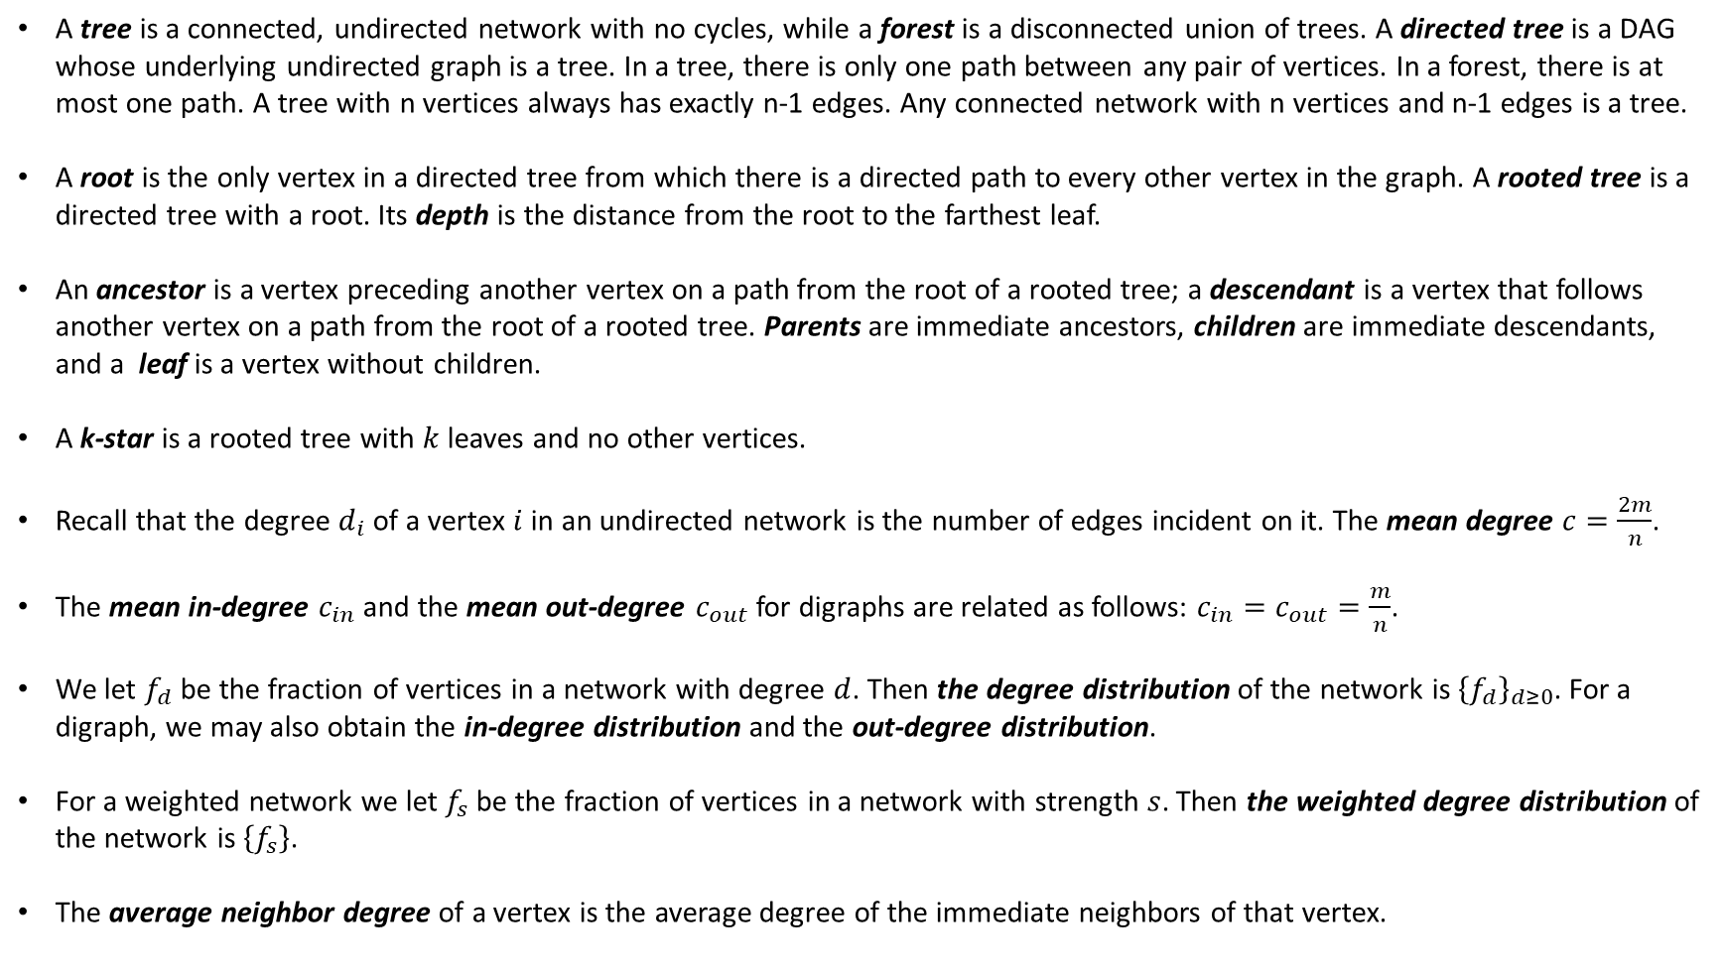
Lecture 4
A tree is a connected, undirected network with no cycles, while a forest is a disconnected union of trees. A directed tree is a DAG whose underlying undirected graph is a tree. In a tree, there is only one path between any pair of vertices. In a forest, there is at most one path. A tree with n vertices always has exactly n-1 edges. Any connected network with n vertices and n-1 edges is a tree.
A root is the only vertex in a directed tree from which there is a directed path to every other vertex in the graph. A rooted tree is a directed tree with a root. Its depth is the distance from the root to the farthest leaf.
An ancestor is a vertex preceding another vertex on a path from the root of a rooted tree; a descendant is a vertex that follows another vertex on a path from the root of a rooted tree. Parents are immediate ancestors, children are immediate descendants, and a leaf is a vertex without children.
A k-star is a rooted tree with $k$ leaves and no other vertices.
Recall that the degree $d_{i}$ of a vertex $i$ in an undirected network is the number of edges incident on it. The mean degree $c=\frac{2m}{n}$.
The mean in-degree $c_{in}$ and the mean out-degree $c_{out}$for digraphs are related as follows: $c_{in}=c_{out}=\frac{m}{n}$.
We let $f_{d}$ be the fraction of vertices in a network with degree $d$. Then the degree distribution of the network is ${\left\{f_{d}\right\}}_{d≥0}$. For a digraph, we may also obtain the in-degree distribution and the out-degree distribution.
For a weighted network we let $f_{s}$ be the fraction of vertices in a network with strength $s$. Then the weighted degree distribution of the network is $\left\{f_{s}\right\}$.
The average neighbor degree of a vertex is the average degree of the immediate neighbors of that vertex.

Slide 8
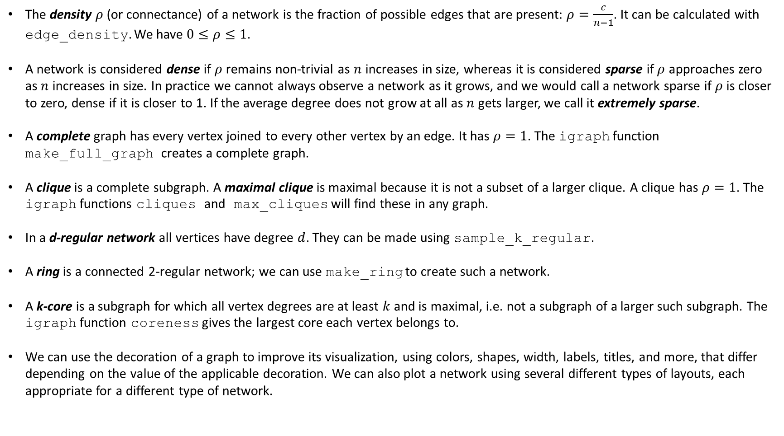
Lecture 5
The density $ρ$ (or connectance) of a network is the fraction of possible edges that are present: $ρ=\frac{c}{n−1}$. It can be calculated with edge_density. We have $0≤ρ≤1$.
A network is considered dense if $ρ$ remains non-trivial as $n$ increases in size, whereas it is considered sparse if $ρ$ approaches zero as $n$ increases in size. In practice we cannot always observe a network as it grows, and we would call a network sparse if $ρ$ is closer to zero, dense if it is closer to 1. If the average degree does not grow at all as $n$ gets larger, we call it extremely sparse.
A complete graph has every vertex joined to every other vertex by an edge. It has $ρ=1$. The igraph function make_full_graph creates a complete graph.
A clique is a complete subgraph. A maximal clique is maximal because it is not a subset of a larger clique. A clique has $ρ=1$. The igraph functions cliques and max_cliques will find these in any graph.
In a d-regular network all vertices have degree $d$. They can be made using sample_k_regular.
A ring is a connected 2-regular network; we can use make_ring to create such a network.
A k-core is a subgraph for which all vertex degrees are at least $k$ and is maximal, i.e. not a subgraph of a larger such subgraph. The igraph function coreness gives the largest core each vertex belongs to.
We can use the decoration of a graph to improve its visualization, using colors, shapes, width, labels, titles, and more, that differ depending on the value of the applicable decoration. We can also plot a network using several different types of layouts, each appropriate for a different type of network.

Slide 9
Lecture 6
We can improve the visualization of a large network if the vertices are split into groups. We may then coarsen the network using the igraph function contract. Alternatively, we can create an egocentric network; we choose a vertex we are most interested in and create an induced subgraph for that vertex and all its neighbors of a certain order. We may use the igraph function make_ego_graph for this.
Two paths connecting a given pair of vertices are edge-independent if they share no edges. They are vertex-independent if they share no vertices other than the start and end vertices. If two paths are vertex-independent, then they are also edge-independent. Vertex- or edge-independent paths are not necessarily unique.
The number of vertex-independent paths between vertices $A$ and $B$ is called the vertex-connectivity of $A$ and $B$. Use vertex_connectivity. Vertex connectivity can be considered as a measure of how strongly connected the vertices in question are.
The number of edge-independent paths between vertices $A$ and $B$ is called the edge-connectivity of $A$ and $B$. Use edge_connectivity.
A graph $G$ is k-vertex-connected iff 1) its order > k, and 2) removing any subset of less than k vertices leaves a connected subgraph. The vertex connectivity of $G$ is the largest integer k such that $G$ is k-vertex connected. Use vertex_connectivity.
A vertex cut set is a set of vertices that disconnects either the graph or a pair of vertices. A minimum vertex cut set is the smallest vertex cut set; this may not be unique. A cut vertex (or articulation point) is a single vertex that disconnects either the graph or a pair of vertices. Use articulation_points.
A graph $G$ is k-edge-connected if 1) its order is $≥2$, and 2) removing any subset of less than k edges leaves a connected subgraph. The edge connectivity of $G$ is the largest integer k such that $G$ is k-edge connected. Use edge_connectivity.
An edge cut set is a set of edges that disconnects the graph.
$\min\left(d_{A},d_{B}\right)≥edge_connectivity(A,B)≥vertex_connectivity(A,B)$ and $\min\left(degree of G\right)≥edge_connectivity(G)≥vertex_connectivity(G)$.
A partition of a graph $G=\left(V,E\right)$ is a decomposition of $V$ into disjoint, nonempty subgraphs $\left\{C_{1},⋯,C_{k}\right\}$(also called communities) such that the union of their vertices equals $V$.
A cohesive subgraph of $G$ is 1) Well-connected among itself and 2) relatively well separated from the rest of $V$.
A good partition $\left\{C_{1},⋯,C_{k}\right\}$ is such that the size (number of edges) of any subgraph $C_{i}$ is relatively large compared to the number of edges connecting $C_{i}$ to any of the other subgraphs. Graph Partitioning, or community detection, amounts to the task of finding a good partition of a network.
The graph Laplacian of an undirected graph $G$ with adjacency matrix $A$ and no loops is the matrix $L=D−A$ where $D$ is the diagonal matrix with the degree of the vertices of $G$ on the diagonal. The igraph function laplacian_matrix obtains it. Let $λ_{n}≥⋯≥λ_{1}≥0$ be the eigenvalues of the graph Laplacian. Then $G$ has k connected components iff $λ_{1}=⋯=λ_{k}=0$ and $λ_{k+1}>0$. Note that $λ_{1}=0$ for all graphs, and so if $λ_{2}>0$, the graph is connected. Small eigenvalues indicate that a graph can be split into subgraphs by severing a relatively small number of edges. The eigenvalue $λ_{2}$ is called the Fiedler value, or the spectral gap, and its corresponding eigenvector the Fiedler vector. If this value is small, we can split the graph into two subgraphs, one containing all vertices for which corresponding values in the Fiedler vector are less than zero, and one containing all other vertices. This method for partitioning a graph is called spectral partitioning. Use cluster_leading_eigen to use this method iteratively; it outputs an R object of type communities.
Hierarchical clustering can be performed in R using cluster_fast_greedy, which outputs an R object of type communities. For an unweighted graph it will try to minimize the number of edges between the subgraphs, for a weighted graph it will try to minimize the weights of the connections between the subgraphs. A dendrogram provides a hierarchy of clustering of a graph. Use plot_dendrogram to see the applicable dendrogram. Use cut_at to obtain a different number of partitions.
The plot function, when given a communities object and a graph, will plot the original graph while indicating the vertices that have been grouped together.
There are several igraph functions that can be used on R objects of type communities; see ?membership.

Slide 10
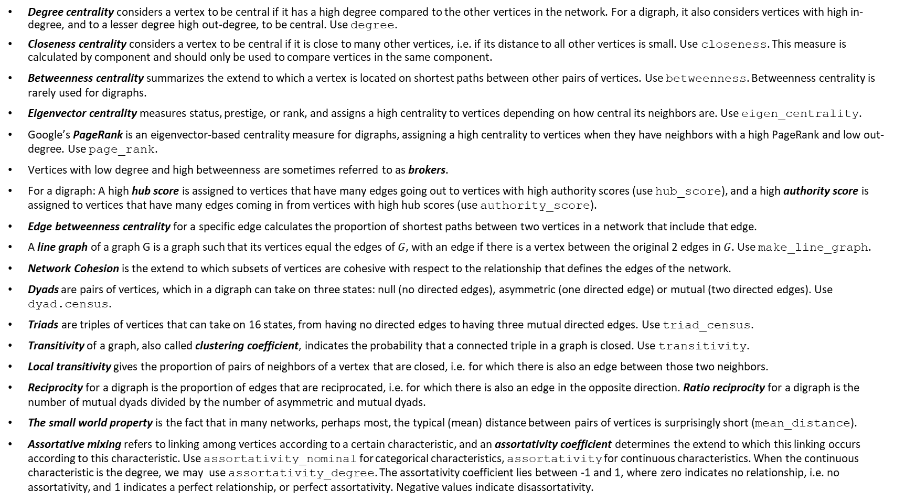
Lecture 7
Degree centrality considers a vertex to be central if it has a high degree compared to the other vertices in the network. For a digraph, it also considers vertices with high in-degree, and to a lesser degree high out-degree, to be central. Use degree.
Closeness centrality considers a vertex to be central if it is close to many other vertices, i.e. if its distance to all other vertices is small. Use closeness. This measure is calculated by component and should only be used to compare vertices in the same component.
Betweenness centrality summarizes the extend to which a vertex is located on shortest paths between other pairs of vertices. Use betweenness. Betweenness centrality is rarely used for digraphs.
Eigenvector centrality measures status, prestige, or rank, and assigns a high centrality to vertices depending on how central its neighbors are. Use eigen_centrality.
Google’s PageRank is an eigenvector-based centrality measure for digraphs, assigning a high centrality to vertices when they have neighbors with a high PageRank and low out-degree. Use page_rank.
Vertices with low degree and high betweenness are sometimes referred to as brokers.
For a digraph: A high hub score is assigned to vertices that have many edges going out to vertices with high authority scores (use hub_score), and a high authority score is assigned to vertices that have many edges coming in from vertices with high hub scores (use authority_score).
Edge betweenness centrality for a specific edge calculates the proportion of shortest paths between two vertices in a network that include that edge.
A line graph of a graph G is a graph such that its vertices equal the edges of $G$, with an edge if there is a vertex between the original 2 edges in $G$. Use make_line_graph.
Network Cohesion is the extend to which subsets of vertices are cohesive with respect to the relationship that defines the edges of the network.
Dyads are pairs of vertices, which in a digraph can take on three states: null (no directed edges), asymmetric (one directed edge) or mutual (two directed edges). Use dyad.census.
Triads are triples of vertices that can take on 16 states, from having no directed edges to having three mutual directed edges. Use triad_census.
Transitivity of a graph, also called clustering coefficient, indicates the probability that a connected triple in a graph is closed. Use transitivity.
Local transitivity gives the proportion of pairs of neighbors of a vertex that are closed, i.e. for which there is also an edge between those two neighbors.
Reciprocity for a digraph is the proportion of edges that are reciprocated, i.e. for which there is also an edge in the opposite direction. Ratio reciprocity for a digraph is the number of mutual dyads divided by the number of asymmetric and mutual dyads.
The small world property is the fact that in many networks, perhaps most, the typical (mean) distance between pairs of vertices is surprisingly short (mean_distance).
Assortative mixing refers to linking among vertices according to a certain characteristic, and an assortativity coefficient determines the extend to which this linking occurs according to this characteristic. Use assortativity_nominal for categorical characteristics, assortativity for continuous characteristics. When the continuous characteristic is the degree, we may use assortativity_degree. The assortativity coefficient lies between -1 and 1, where zero indicates no relationship, i.e. no assortativity, and 1 indicates a perfect relationship, or perfect assortativity. Negative values indicate disassortativity.

